Slide 1



WHO WE ARE

Slide 2
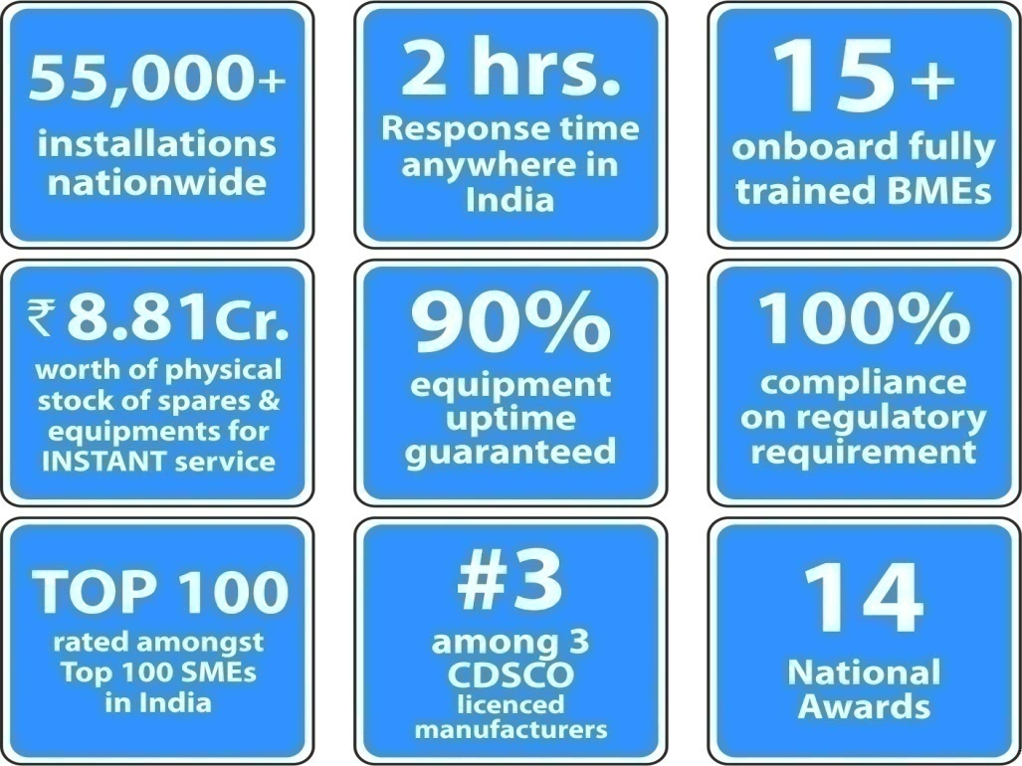
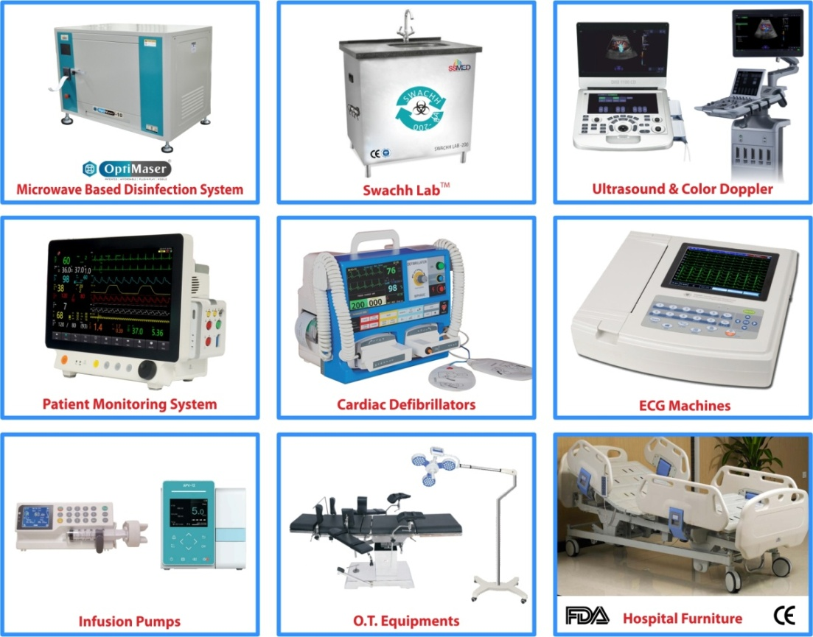
ABOUT US
OUR MAIN PRODUCTS

Slide 3
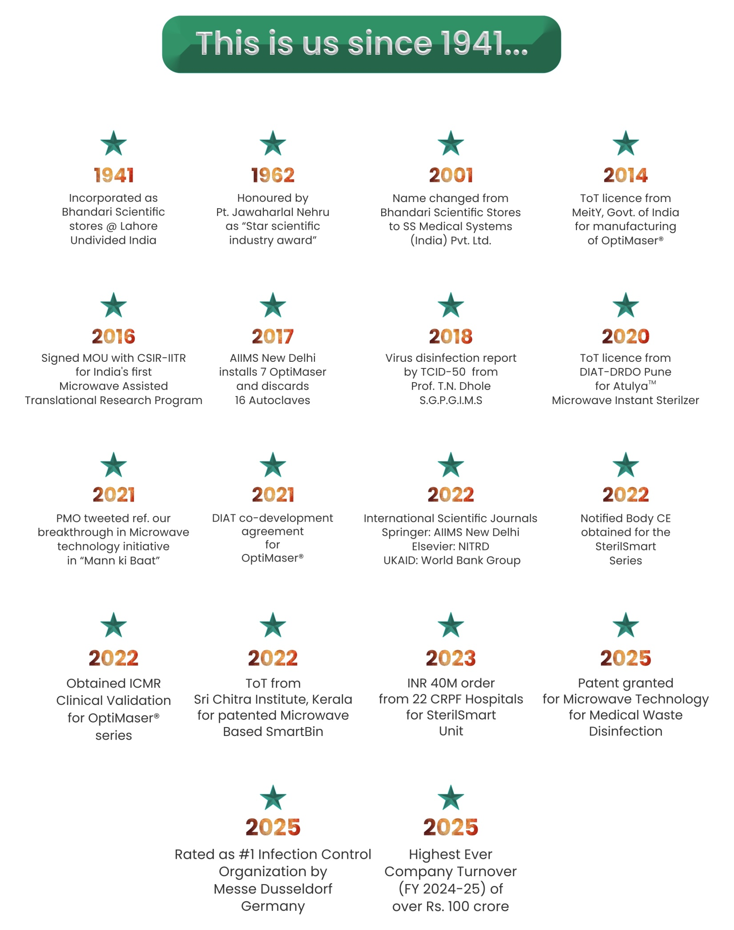

Slide 4





WHO WE ARE ?
We introduce S.S. Medical Systems (1) Pvt. Ltd. proudly introduce ourselves as a company established in 1941 with 85 years of future-proof medical device experience.
Our company has awards & activities to claim it’s presence:
#Rated amongst Top 100 SMEs out of 37134 SME’s nominated.
Class I manufacturer with CE mark products for International Markets.
DSIR registered organization for in-house R&D.
Leading MedTech company of the year 2018, 2019 & 2020.
Health care Excellence Award for the year 2019 by President of IMA.
OUR COLLABORATION
Defence Research and Development Organisation - DRDO
Society for Applied Microwave Electronics Engineering & Research (SAMEER)
Council of Scientific & Industrial Research - Indian Institute Of Toxicology Research
(CSIR-IITR)
Department of Scientific and Industrial Research
(DSIR)
All India Institute of Medical Sciences (AIIMS)

Slide 5

OUR* PRESENCE
NEW DELHI
BHIMTAL
LUCKNOW
LUCKNOW
MUMBAI
AHMEDABAD
VIZAG
BENGALURU
GUWAHATI
KERALA
UNITED KINGDOM
Head Office
Head Office & Factory for SSMED
Factory for OptiMaser
Branch Office
Branch Office
Branch Office
Assembly Unit
Branch Office
Branch Office
Branch Office
#2, New Hawthorne Gardens, Apt. 24, The Hollies, Park Avenue Mosley Hill, Liverpool L18, 8FE, England, U.K.
Driving India ‘s Tech- March to Global presence…
With our* presence in all major locations across India, a dedicated R&D Lab and our own Manufacturing/Assembly Unit, we have pioneered in developing revolutionary products and have been able to serve people Nationally as well as Internationally.

Slide 6
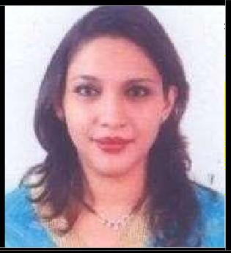
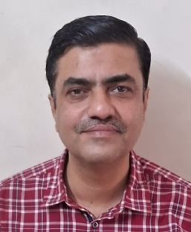
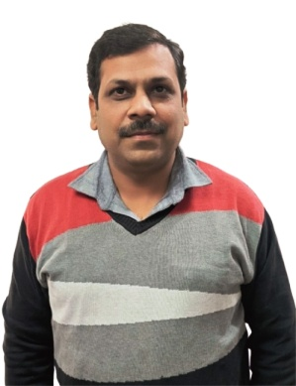
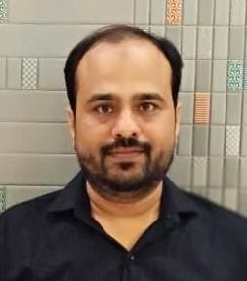
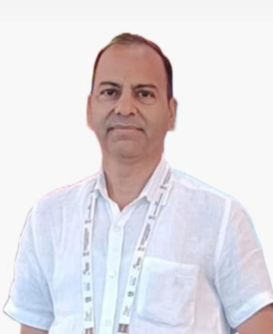
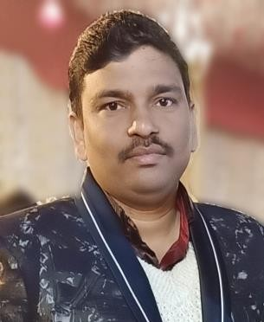
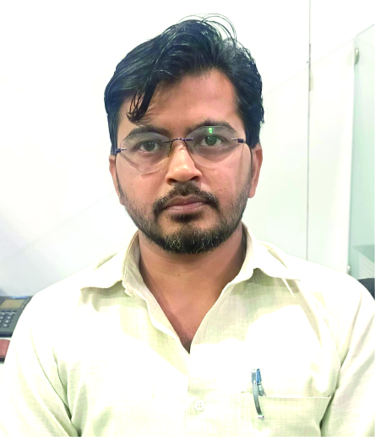
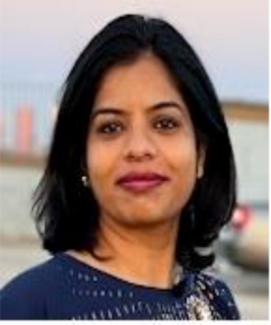
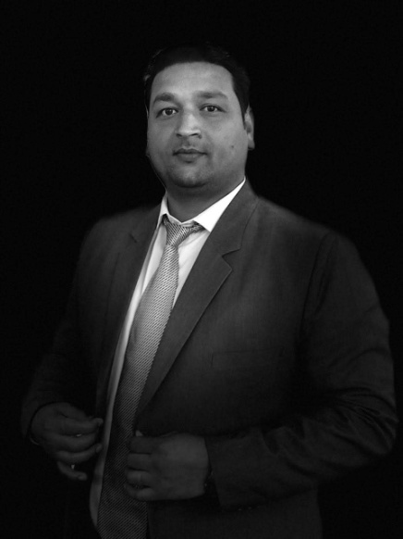
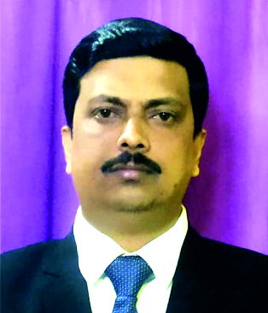
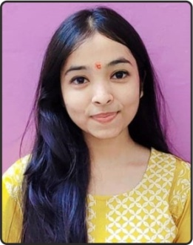
OUR CORE : SS MEDICAL TEAM
Priya Bhandari
Director
Samarth Bajpai
Manager -Operations & Legal
Atul Mishra
Service Head
Adnan Waris
Manager -GeM & Tenders
Jogender Chandra
National Sales Manager
Ritesh Gupta
Manager- Admin & Operations
Ahmed Dullaha
Manager - Service
Jhilmil Varsha
HR Lead
Prem Prakash Shukla
Regional Manager-North
Sibotosh Bhattacharjee
RSM - East
Arunima Srivastava
HR Executive

Slide 7

14 National Awards

Slide 8


Slide 9

HR TEAM
Jhilmil Varsha | HRBP | head.hr@ssmedworld.com
Arunima Srivastava | HR Executive | hrd@ssmedworld.com
Pragya Upreti | Trainee – HR | hr.trainee.ssmed@gmail.com
HOD
Ms. Priya Bhandari
priya@ssmedworld.com

Slide 10
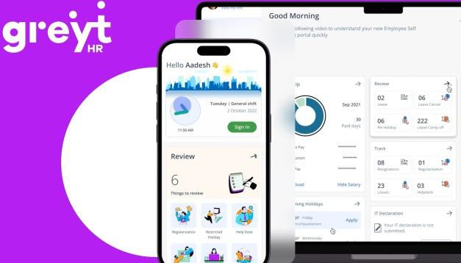
Attendance Policy
Attendance App : GreytHR
Available on Google play store link :
https://play.google.com/store/apps/details?id=com.greytip.ghress&hl=en_IN
Attendance Portal Desktop URL : https://ssmedical.greythr.com/
Office Hours (MON – SAT) : 9.30 am to 6.30 pm
Grace minutes allowed for PUNCH IN : 15 mins
Attendance PUNCH IN / PIUNCH OUT only via GreytHR app with GPS ON in your Mobile Phone.
All Attendance schedule related issues to be Regularized via app only. Employees should monitor their attendance & follow the attendance guidelines.
Any unmarked attendance in the calendar will result in LOP
Attendance cycle is 25th to 24th of every month.
NOTE | Any employee marking attendance after 9:45 AM will be considered as late and on every 3 late, one day absent will be marked which will be adjusted from the leave balance, if available, else from salary.

Slide 11
Leave Policy
All employees will be getting leaves on pro rata basis upon their joining and will be credited as mentioned below via GreytHR
Type of Leave | Number / Financial Year | Calculation / Conditions
EL (Earned Leave) | 15 | Pro-rata basis: 1.25 days per month
CL (Casual Leave) | 12 | Pro-rata basis: 1 day/month
SL (Sick Leave) | 7 | Approved on medical grounds
Half Day | - | Subject to approval
Compensatory Off | On approval | 1 day comp off for working on 1 non-working day
Work From Home | On approval | Eligible for 70% of day salary
ML (Maternity Leave) | 3 months (first two children only) | Applicable only for first two children
EXCEPT CL other leaves are credited on GreytHR after completion of 06 months of probation of an employee.
Employees are eligible to apply leaves only via GreytHR app.
Employees who take unapproved leave will be marked as “Absent x2”. Employee will lose 2 days (gross pay) of pay for every 1 day of
unapproved leave.
EL are subject to encashment at end of FY in March as per the actuals
Annual Leave Calendar is April to March.
All the leave balance are subject to be lapsed if not availed within the current FY (Apr – Mar).
Sick Leaves above 1 day requires medical prescriptions & supported with proof for acceptance.
Comp Offs are accumulated, and unused Comp. Offs are paid at 1.5 times (1 Comp Off = 1.50 day (Basic + DA of gross salary)) at the end of the financial year.

Slide 12
Holidays /Week Off/ Work from Home (WFH)
Annual Holiday Calendar (Apr – Mar) is uploaded in GreytHR with all Restricted & Gazette Holidays for the complete year.
Organization follows the Holiday Calendar year & employees can align their holiday plans accordingly
Week Off is observed on every Sunday. Any work commitment or requirement if applicable on Sunday then employee can avail a Compensatory off as per the policy
Work From Home Guideline & Restrictions
WFH applicable for confirmed employees only after successful completion of 06 months probation
WFH is EXCLUDED for Field Sales/ Service employees. Backend sales team can avail the WFH benefit
Only 70% of salary will be considered while working under WFH.
Employee has to ensure his/ her availability for Telephonic/ Video meetings during the official hours i.e.
9.30 am to 6:30 pm
Regular reporting to the manager & HODs to be maintain during WFH
WFH can be availed only for 06 days in a month twice with 3days tenure basis the necessary approvals.
Unapproved WFH can lead to strict actions & compliance as per the HR policy

Slide 13
Prevention of Sexual Harassment (POSH)
The Company believes that Sexual Harassment at workplace is a grave offence. The Company holds the responsibility to identify and prevent Sexual Harassment and to develop a culture of "zero tolerance" for any form of Sexual Harassment at the Workplace.
The Company shall respond promptly to reports of Sexual Harassment and will take appropriate steps to discipline behavior that violates this Policy and if necessary, facilitate legal action. This Policy is applicable across the Company in all its Workplace.

Slide 14
Advances & Travel Expense Report (TER) Policy
We follow TER policy for Grades (G1 to G3L3) levels across the board for work related travel
Travel Allowances along with maximum limit as per the grade is shared separately as an Annexure in the offer letter
All employees are adhere to follow the TER policy for timely reimbursement.
Submission timeline for TERs in GreytHR is 25th of every month.
TERs will not be considered if hard copy of bills are not submitted in Accounts Department by the 5th of every month. Only food allowance will be considered and cleared at 100%.
Delay submission of TERs are liable for 5% per week deduction of approved amount.
Employees are required to completely filled the TERs in prescribed format & get them approved by their managers for timely reimbursement
TER advance requests must be submitted at least 24 hours before the tour's commencement. Upon
approval by the Reporting Manager and subsequent submission to accounts, advances will be promptly released by Accounts Department within 1 working day of receiving the advance request.
Only approved advance amount by the manager will be credited to the employee’s account.
Applicable TERs & City wise allowance classification can be thoroughly read in TER policy by the employees

